Slide 1
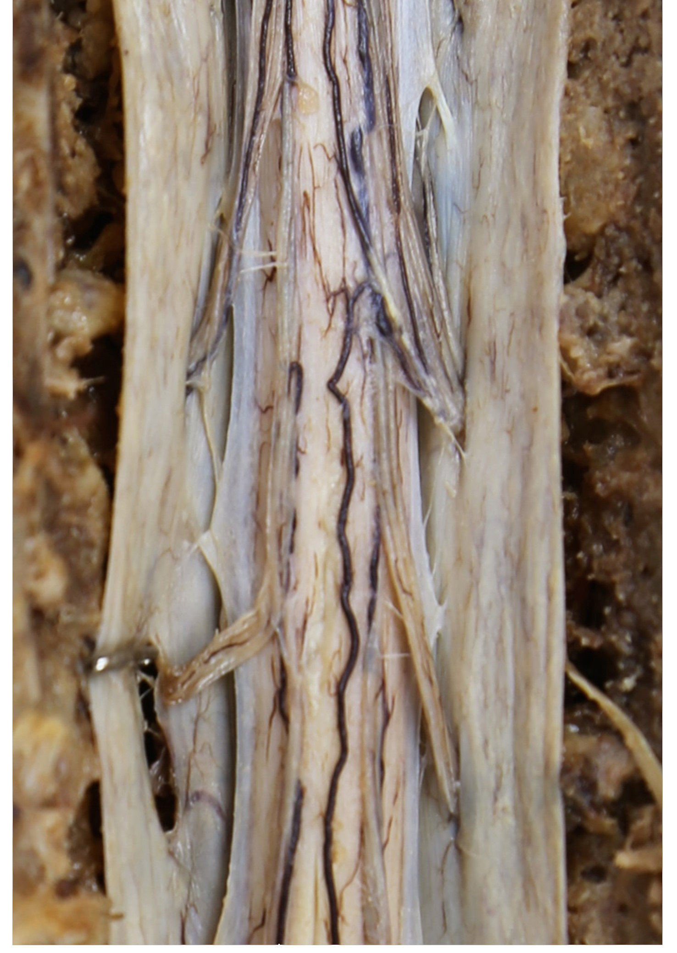

Spinal Cord
Objectives:
To understand basic spinal cord anatomy and be able to differentiate among different spinal cord levels
To identify functional areas of the gray and white matter
To identify spinal arteries and the areas they supply
Specimens needed:
Plastinated spinal cord
Spinal cord model

Slide 2
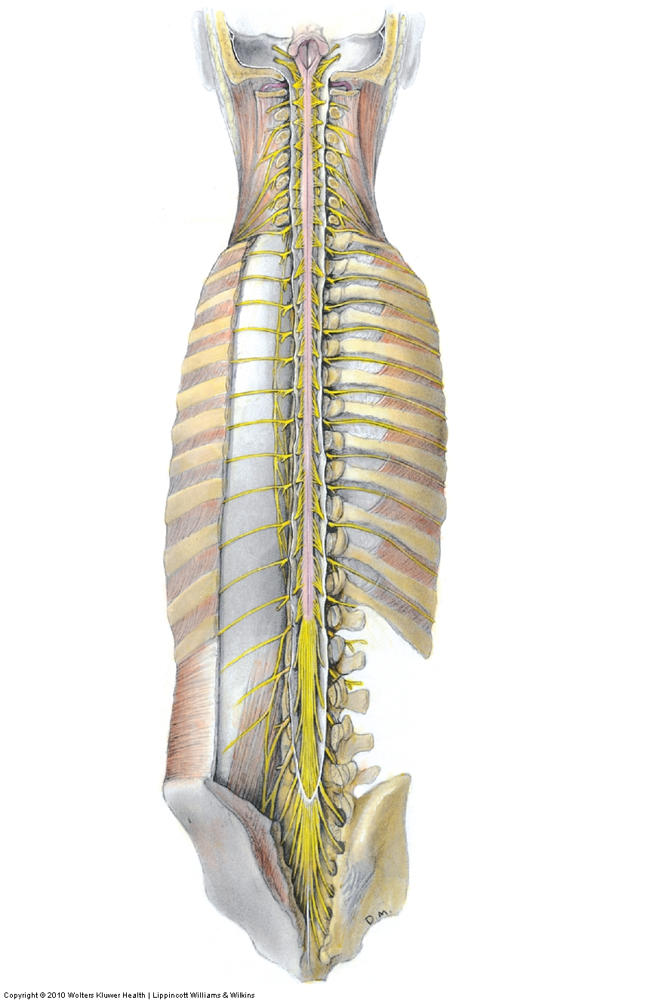
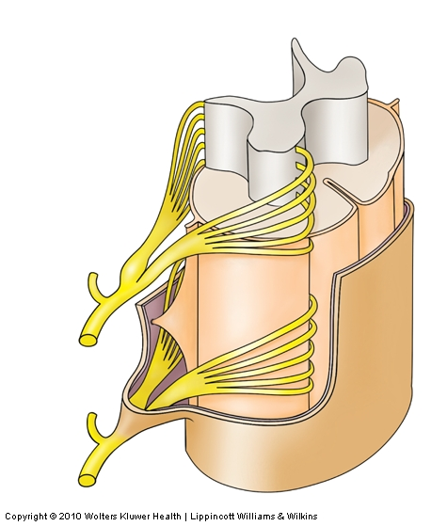
Spinal Cord
The spinal cord begins at the base of the brain stem and continues within the vertebral column to ~ L_{1.}
The spinal cord is covered by the same three meningeal layers as the brain.
The dura mater extends beyond the end of the spinal cord and forms the dural sac.
Dura mater
L₁
Dural sac
Dural sheath

Slide 3
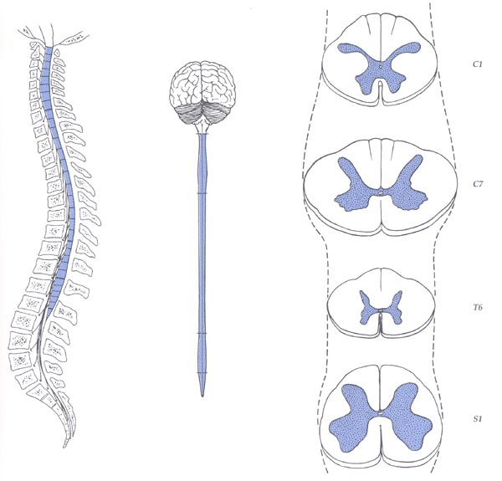
Regions and Enlargements
cervical
thoracic
lumbar
sacral
coccygeal
cervical
enlargement
Conus Medullaris
at L1-L2
vertebral level
in the adult
L2
lumbo-sacral
enlargement
Cauda Equina
from L2
into the sacral
canal

Slide 4
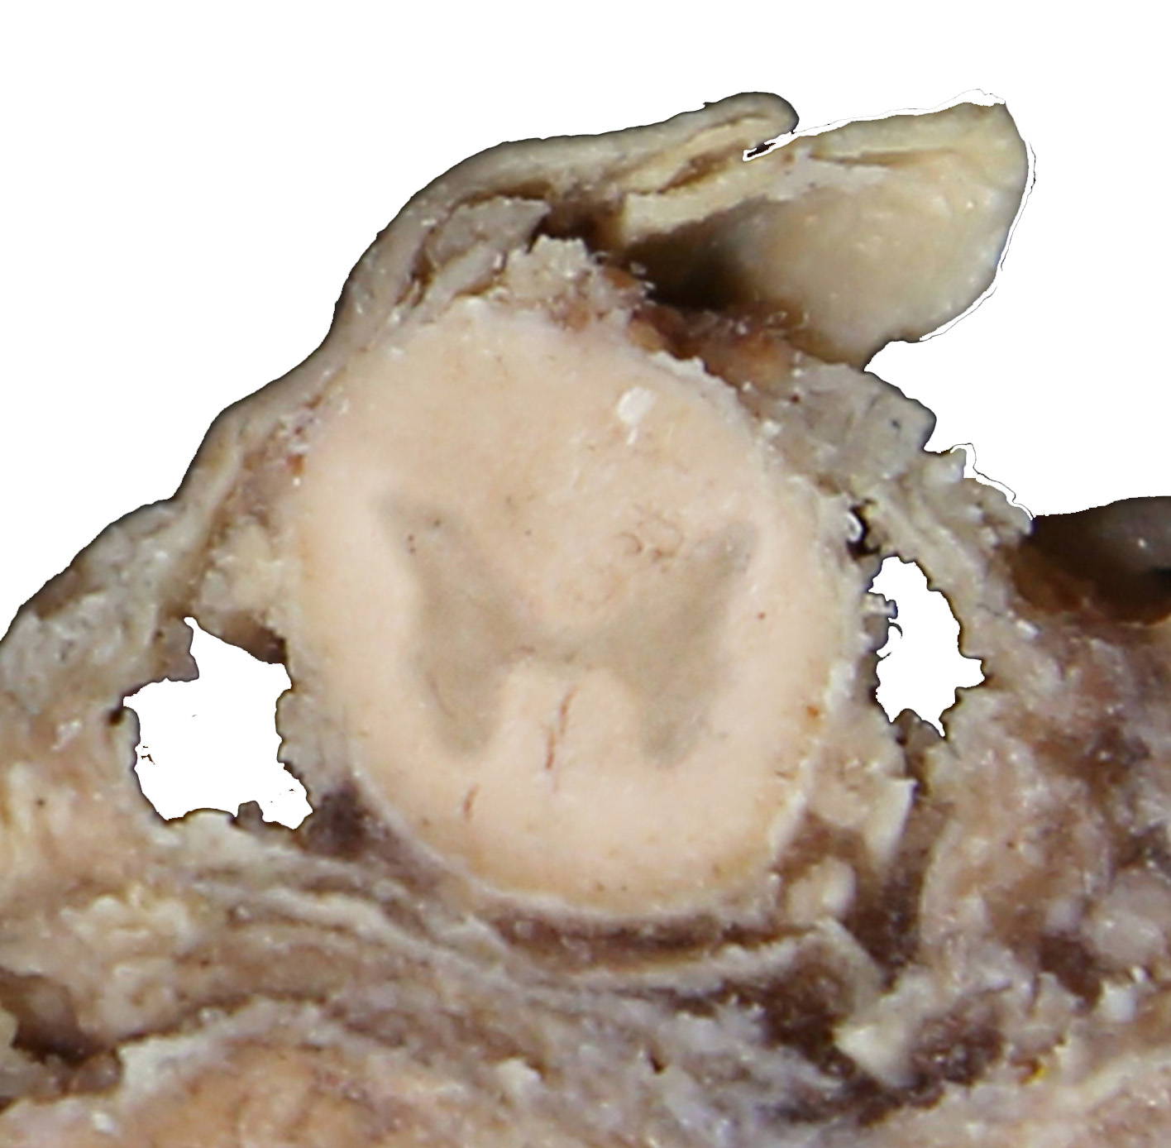
Spinal Cord In Situ
Dorsal funiculus
Dorsal horn
Lateral
funiculus
Ventral horn
Ventral funiculus

Slide 5
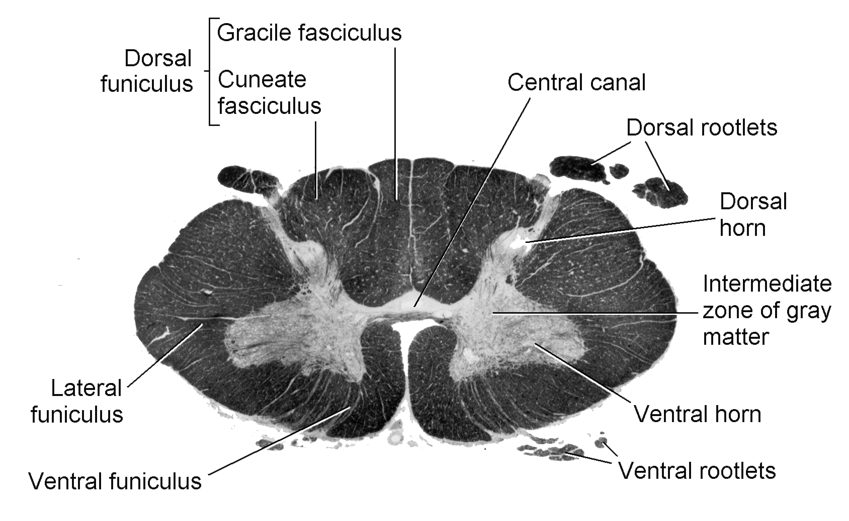
Spinal Cord
The cervical spinal cord is characterized by the cervical enlargement and a relatively large amount of white matter

Slide 6
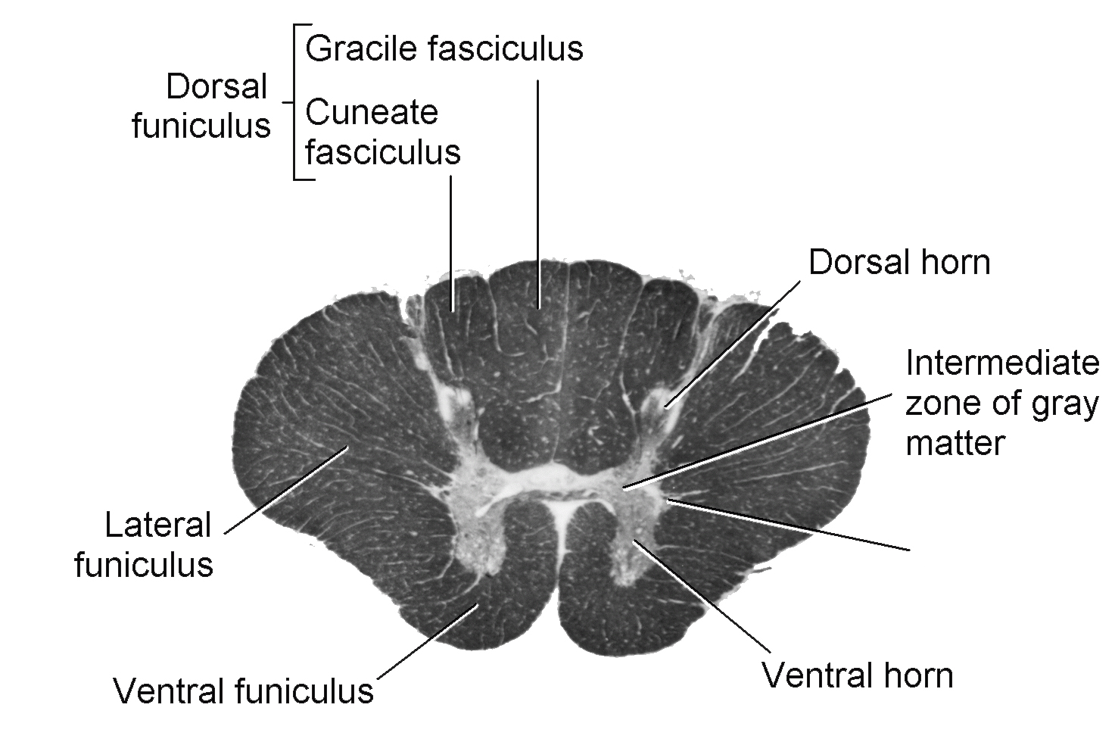
Spinal Cord
The thoracic spinal cord has less gray matter and the intermediolateral (IML) cell column is visible.
IML

Slide 7
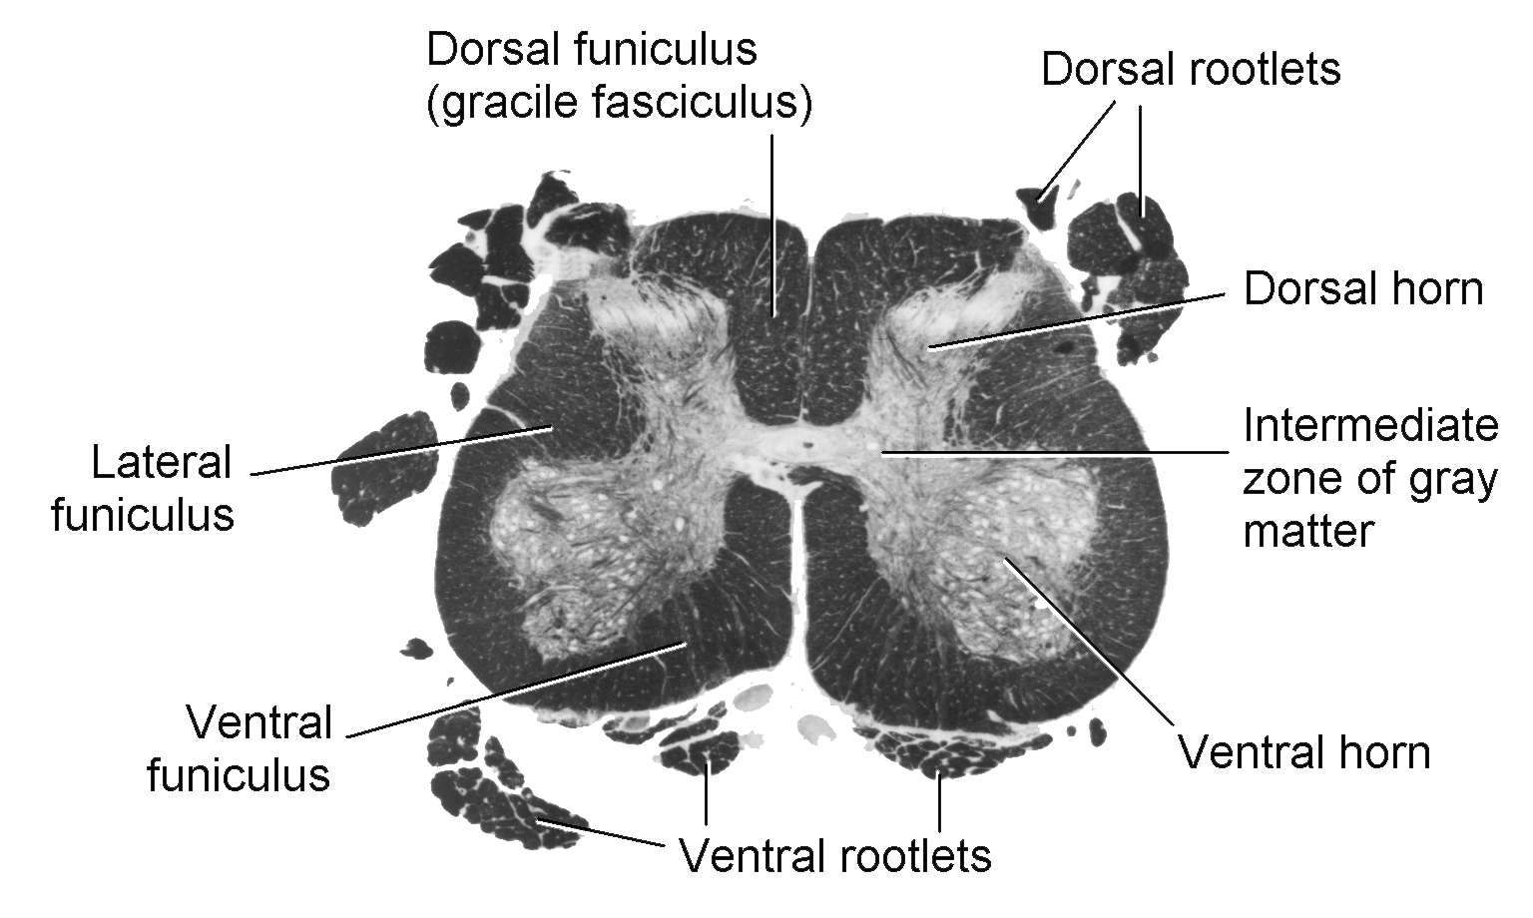
Spinal Cord
The lumbar spinal cord is characterized by the lumbar enlargement and a relatively small amount of white matter

Slide 8
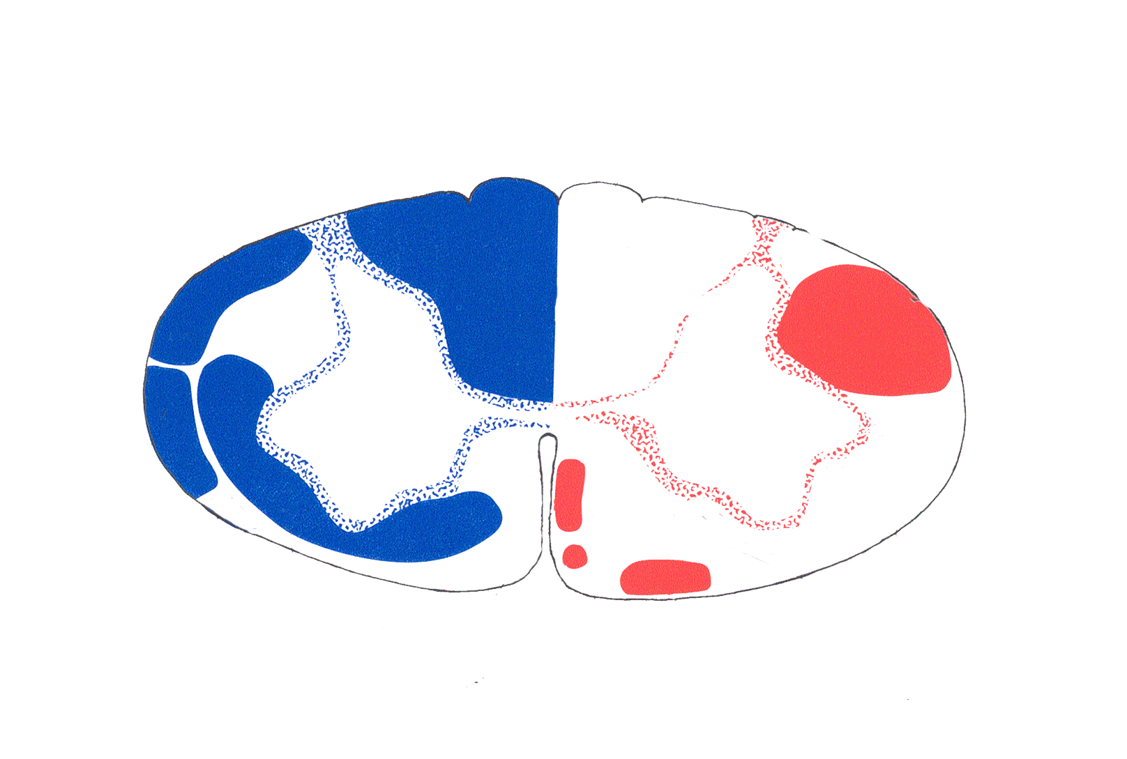
Spinal Cord
Ascending
Descending
Dorsal Column
Cuneate
fasiculus
Gracile
fasiculus
Lateral
Corticospinal tract (lateral descending system, control of distal muscles)
Spinocerebellar tracts
Dorsal
Ventral
Anterolateral system
Medial descending system
(multiple sources, control of axial muscles)

Slide 9
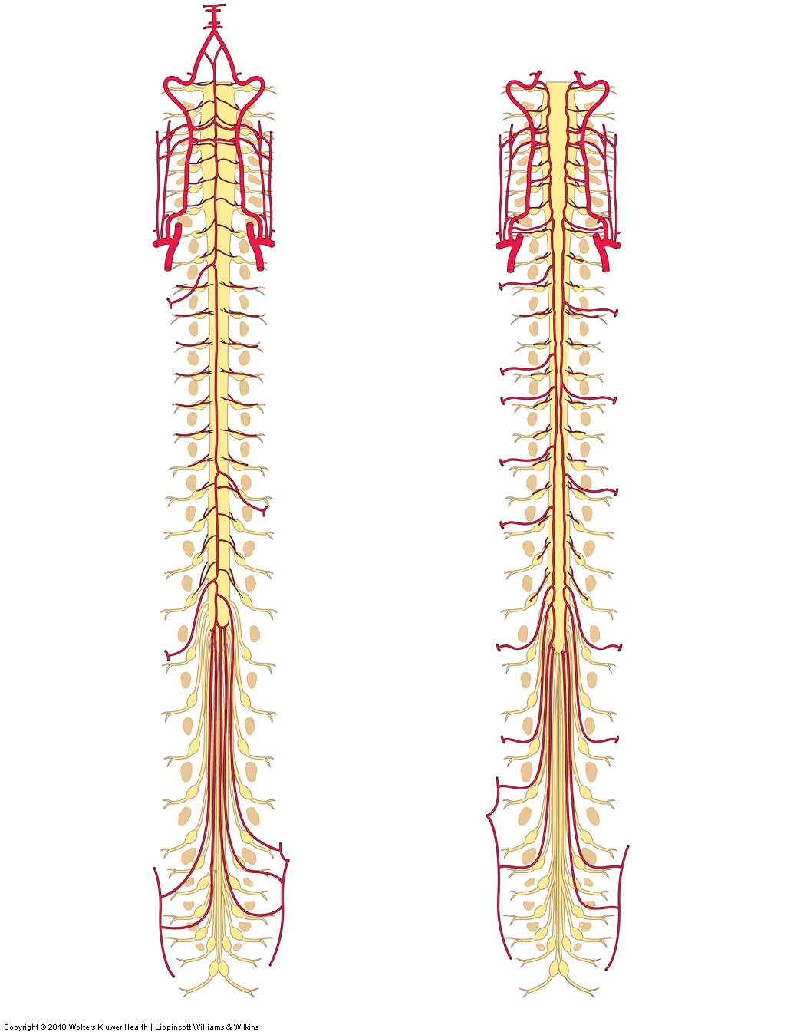
Spinal Cord
Dorsal (posterior)
2 spinal arteries
Source: Vertebral a. or
Posterior inferior cerebellar a.
Ventral (anterior)
1 spinal artery
Source: Vertebral a.
Dorsal and ventral spinal arteries are supplemented by branches from the aorta

Slide 10
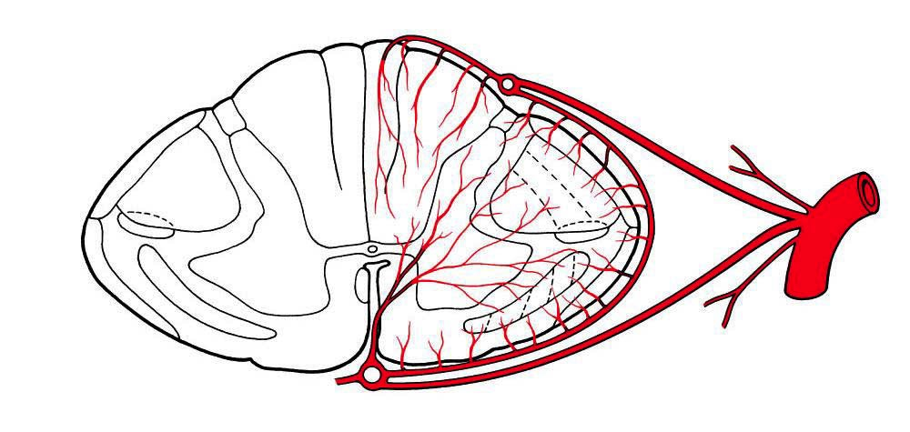
Spinal Cord
Areas served by the dorsal and ventral spinal arteries

Slide 11
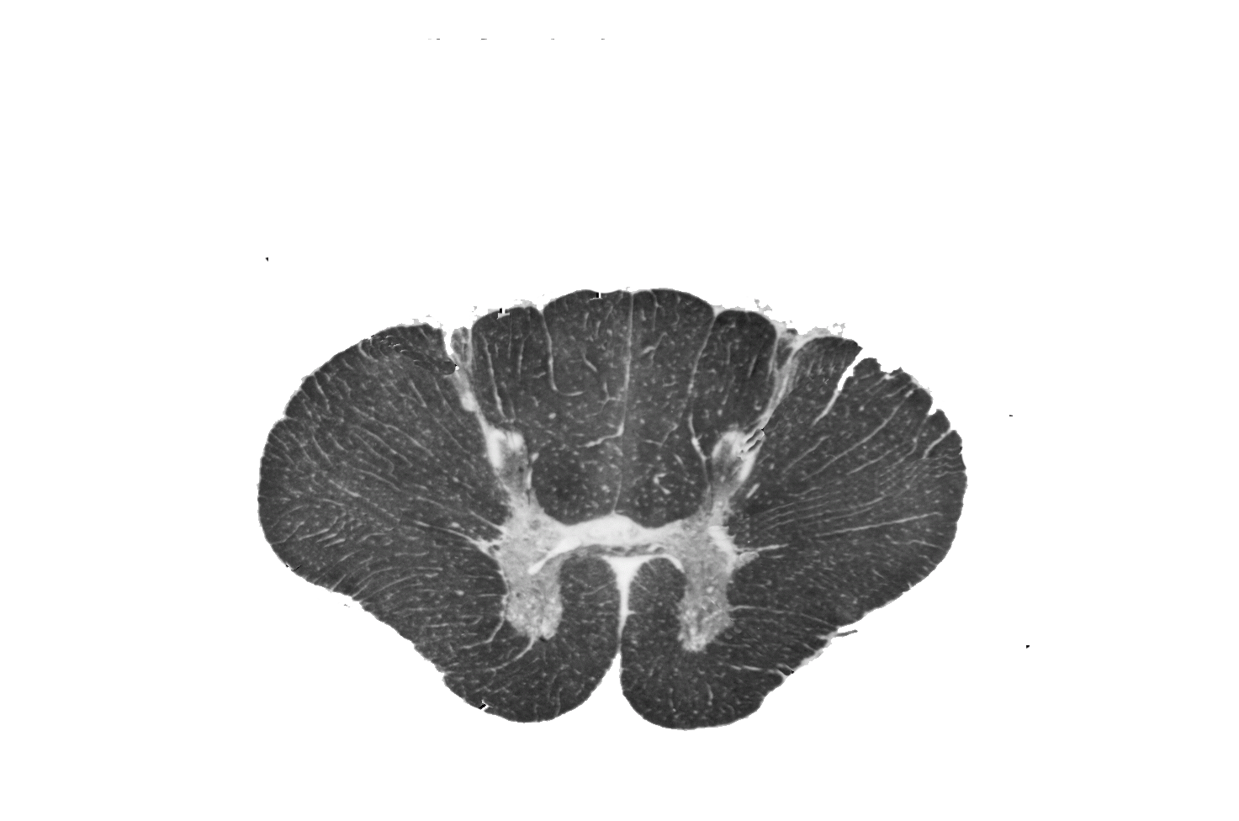
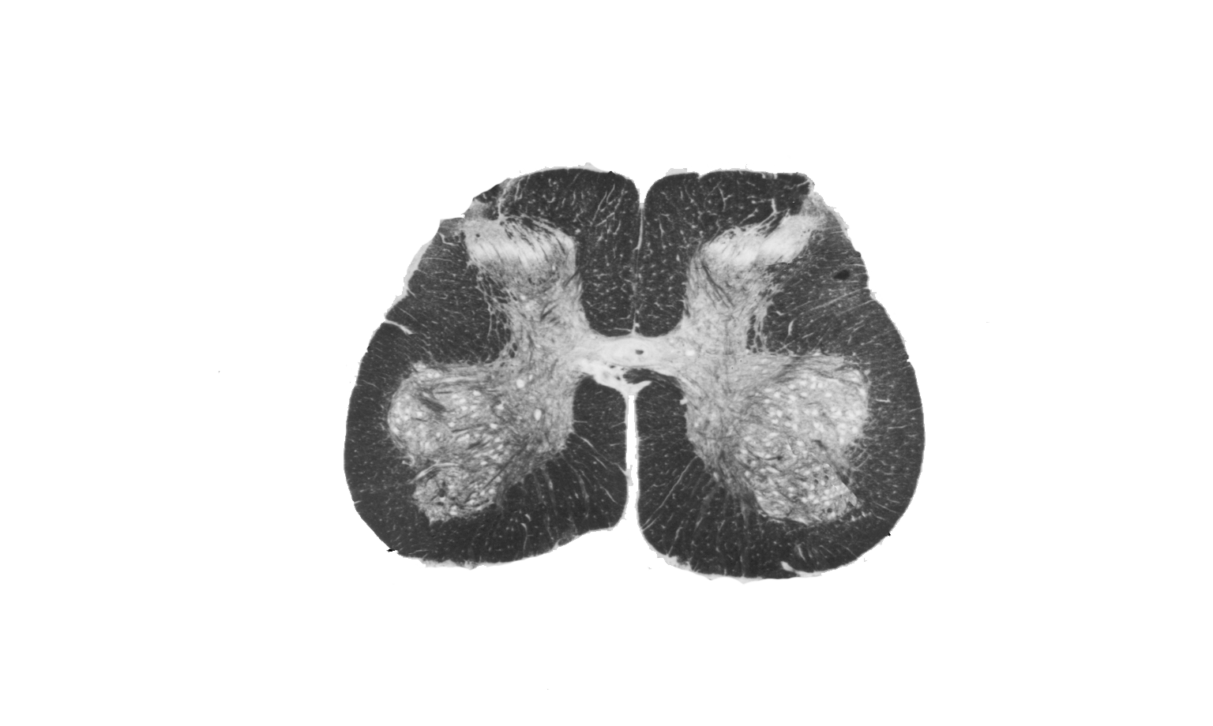
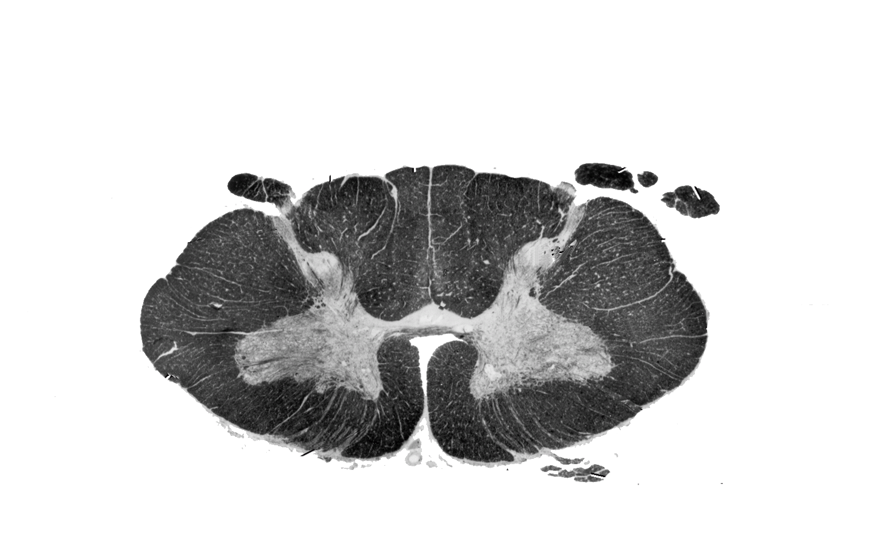
Question 1
Which level(s) contain both the fasciculus cuneatus and gracilis?
Which level(s) contain the intermediolateral cell column?
Which level(s) contain the lumbar enlargement?
Which level(s) contain the cervical enlargement?
A
B
C

Slide 12
Answers
B and C (the section below represents the upper thoracic cord)
B
A
C
A
B
C

Slide 13
Question 2
Match the letters below to the following structures, letters may be used more than once.
1. Anterolateral system 5. Lateral corticospinal tract
2. Dorsal column 6. Medial descending system
3. Fasciculus cuneatus 7. Spinocerebellar tracts
4. Fasciculus gracilis
A
B
C
D
G
E
F

Slide 14
Answers
1. E
2. A
3. B
4. C
5. G
6. F
7. D
A
B
C
D
G
E
F

